Slide 1
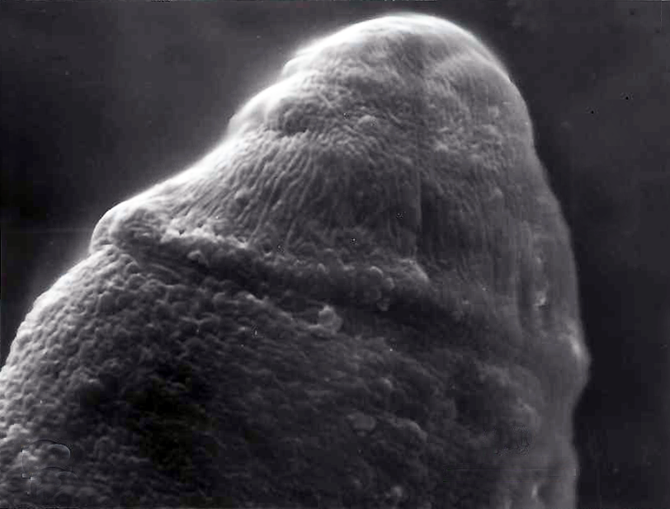
OS
Supplementary Fig. S1. A 12-h-old metacercaria of Isthmiophora hortensis obtained from an experimentally infected tadpole showing the presence of a head collar (arrows) but no collar spines yet. A dorsolateral view. OS, oral sucker. Scale bar = 10 μm.

