Slide 1
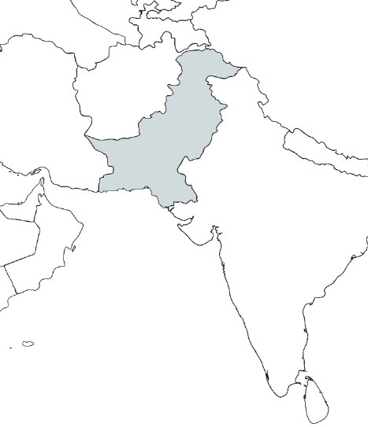
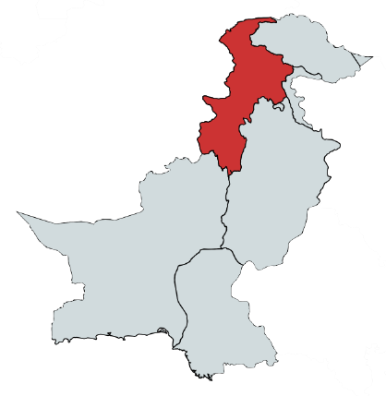
Tajikistan
China
KP
Afghanistan
Iran
Pakistan
Nepal
Oman
India
Fig. S1. Map of Khyber Pakhtunkhwa (KP) Province, Pakistan.

