Slide 1
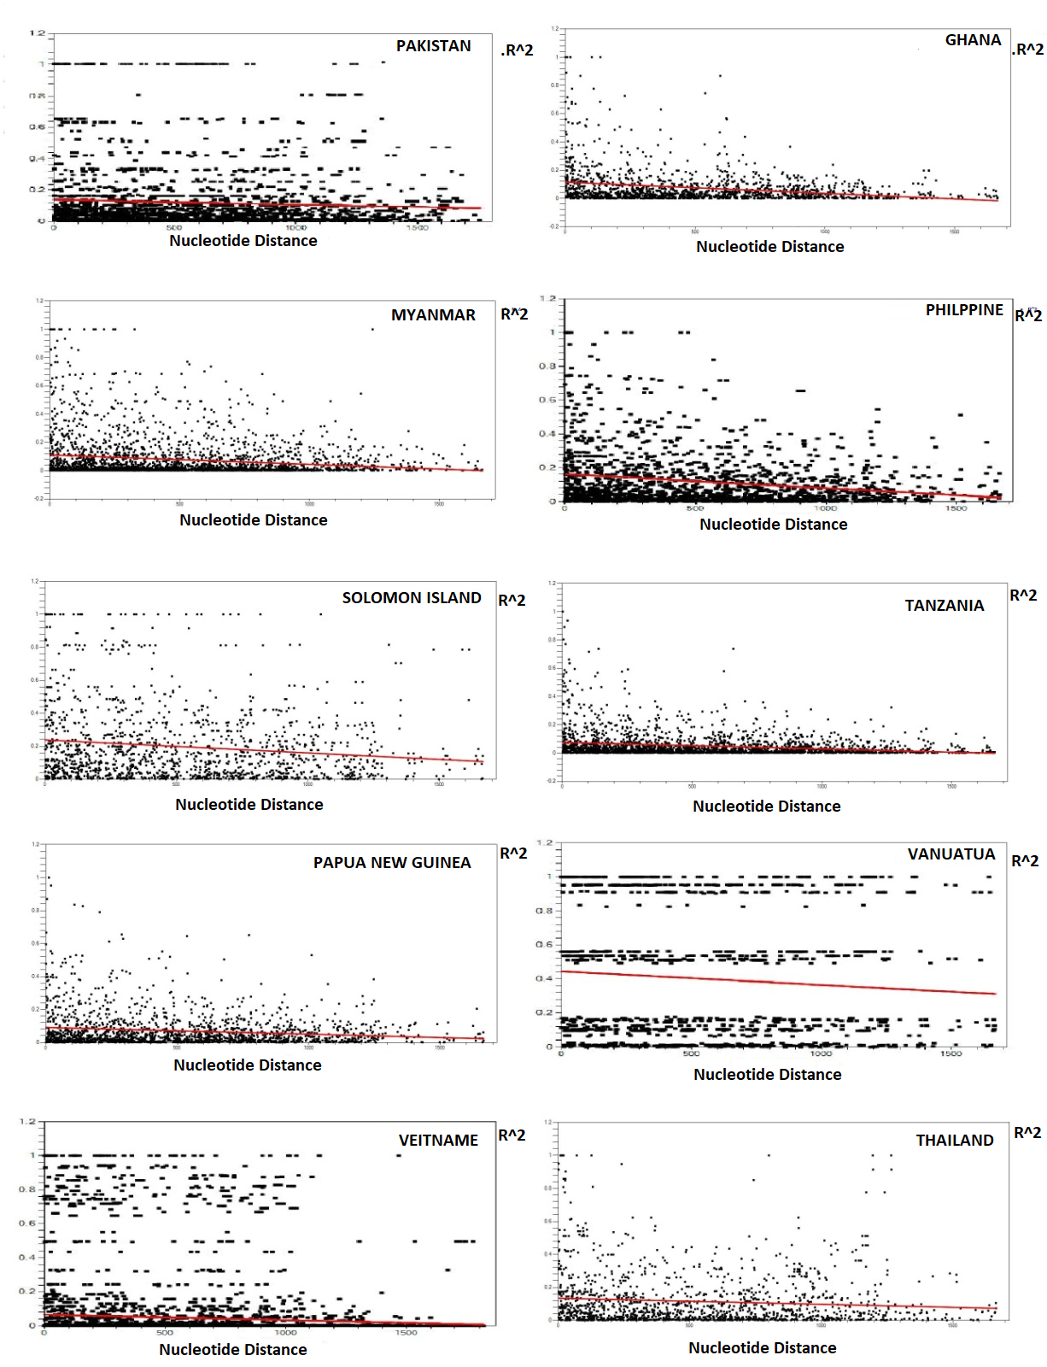
KP-Pakistan
Ghana
R²
R²
Myanmar
Philippines
R²
R²
SI
Tanzania
R²
R²
PNG
Vanuatu
R²
R²
Vietnam
Thailand
R²
R²
Fig. S2. Recombination event in global pfama-1. The linkage disequilibrium (LD) plot suggested nonrandom associations between nucleotide variations in pfama-1 at different polymorphic sites. R² values were plotted against nucleotide distance using a two-tailed Fisher’s exact test for statistical significance. SI, Solomon Islands; PNG, Papua New Guinea.

